Slide 1
1
Introduction to Information Systems

Slide 2
Chapter Outline
Overview of Information Technology (IT).
Overview of Computer-Based Information Systems (IS/MIS/CIS/CBIS).
How Does IT Impact Organizations?
Importance of IS/MIS/CIS/CBIS to Society
Why Should We Study IS/MIS/CIS/CBIS?
And, How?

Slide 3
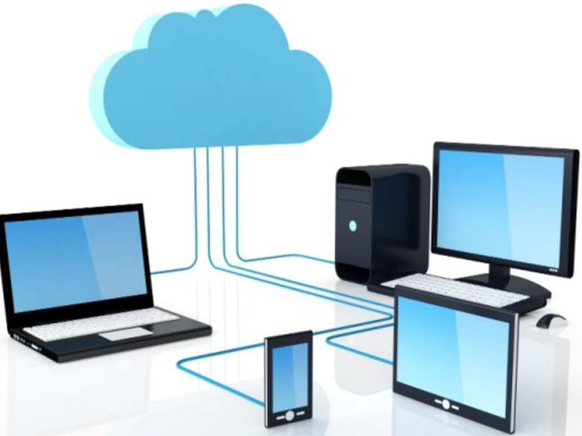
Intro to IS/MIS/CIS/CBIS
Information Technology (IT): Any computer-based tool that people use to work with data and to support the information and information-processing needs of an organization.
  Hardware
  Software
  Network: Internet and Web, extranets, intranets
  Data Management Technology

Slide 4
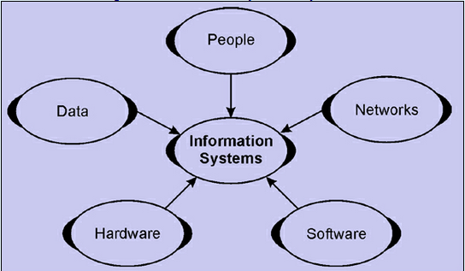
Intro to IS/MIS/CIS/CBIS
Information System (IS): A collection of information technologies that are used to collect, process, store, analyzes, and disseminate information for a specific purpose.

Slide 5
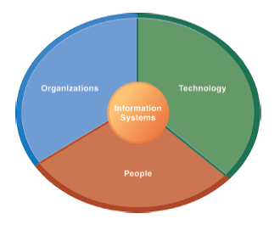
IS/MIS/CIS/CBIS Isn’t Simply Technology: The Role of People and Organizations
IS/MIS/CIS/CBIS Are More than Computers
Using IS effectively requires an understanding of the organization, people, and IT shaping the systems.
An IS provides a solution to important business problems or challenges facing the firm.

Slide 6
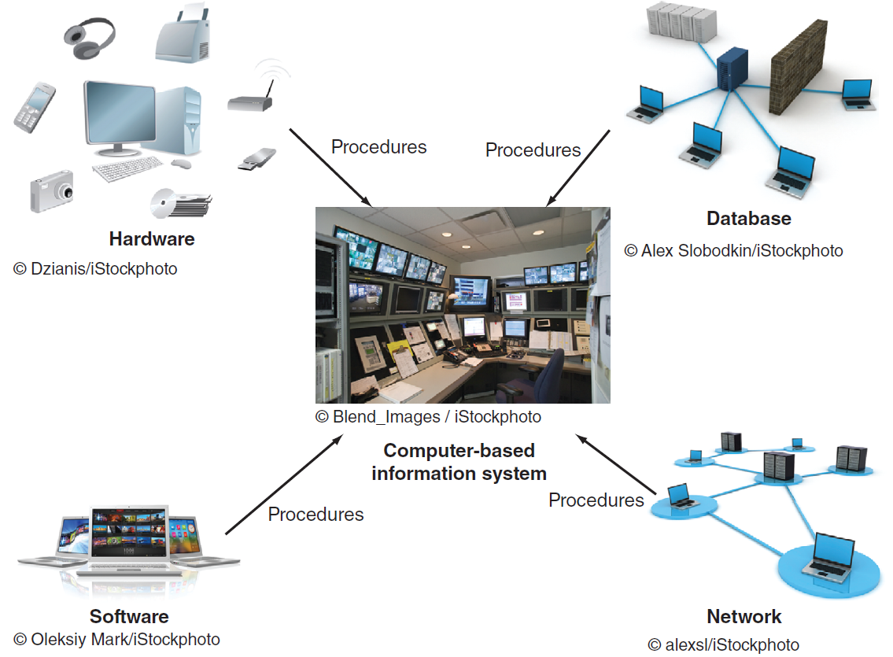
Components of an IS/MIS/CIS/CBIS
Hardware: consists of devices such as the processor, monitor, keyboard, and printer.
Software: a program or collection of programs that enable the hardware to process data.
Database: a collection of related files or tables containing data.
Network: a connecting system (wireline or wireless) that permits different computers to share resources.
Procedures: are the instructions for combining the above components to process data and generate the desired output.
People: individuals (personnel, users, managers) who use the hardware and software, interface with it, or utilize its output in an organizational setting.

Slide 7
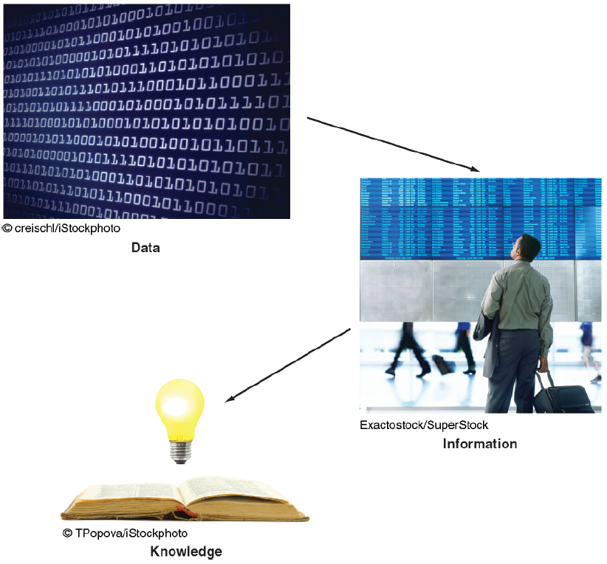
IS/MIS/CIS/CBIS Are More than Computers
Data: an elementary description of things, events, activities, and transactions that are recorded, classified, and stored but are not organized to convey any specific meaning.
Information: refers to data that have been organized so that they have meaning and value to the recipient.
Knowledge: consists of data and/or information that have been organized and processed to convey understanding, experience, accumulated learning, and expertise as they apply to a current business problem.

Slide 8
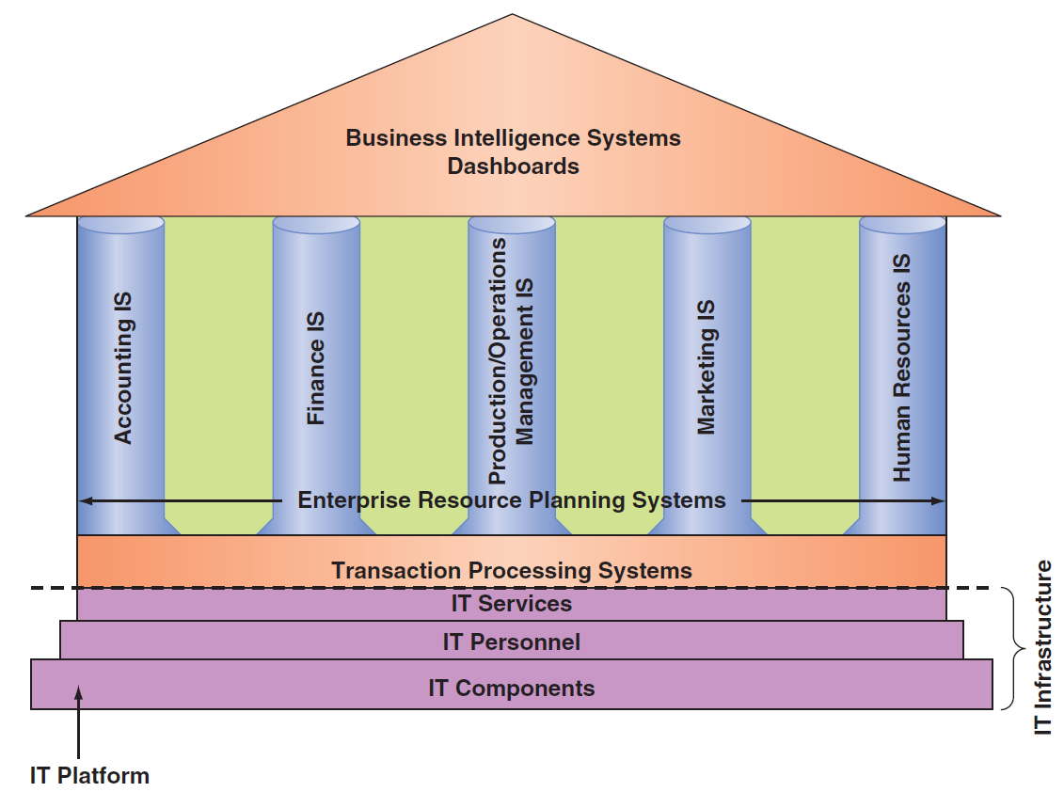
IS/MIS/CIS/CBIS
IT Components: Hardware, Software, a database, a network, procedures, and people.
IT Services: IT Personnel use IT Components to develop IS, oversee security & risk, and manage data.
IT Infrastructure: The IT components and IT services.
Application: A program designed to support a specific task or business process.

Slide 9
Types of IS/MIS/CIS/CBIS
Functional Area Information Systems (FAIS) : a collection of application programs in a single department or functional area.
Enterprise Resource Planning (ERP): IS that are designed to correct a lack of communication among the FAIS.
Transaction Processing System (TPS): IS that support the monitoring, collection, storage, and processing of data from the organization’s basic business transactions, each of which generates data.
Inter-organizational Information systems (IOSs): Information systems that connect two or more organizations.
Electronic Commerce (e-commerce) Systems: an inter-organizational information system that enable organizations to conduct transactions, called business-to-business (B2B) electronic commerce, and customers to conduct transactions with businesses, called business-to-consumer (B2C) electronic commerce.

Slide 10
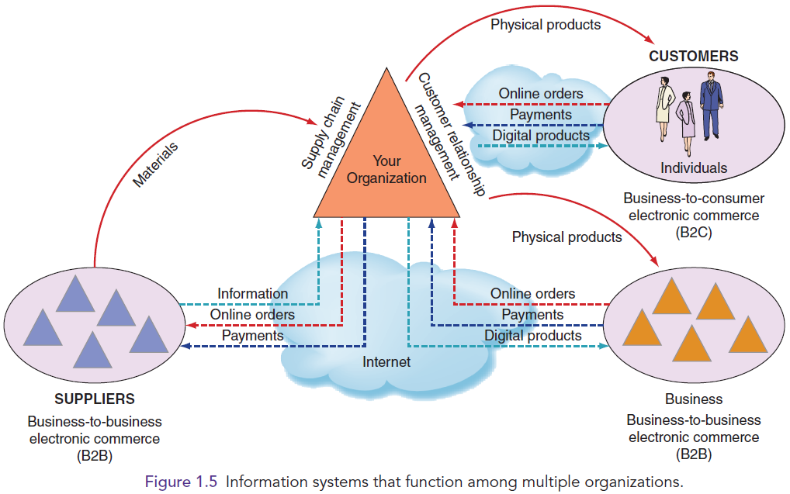
IS/MIS/CIS/CBIS that function among multiple organizations

Slide 11
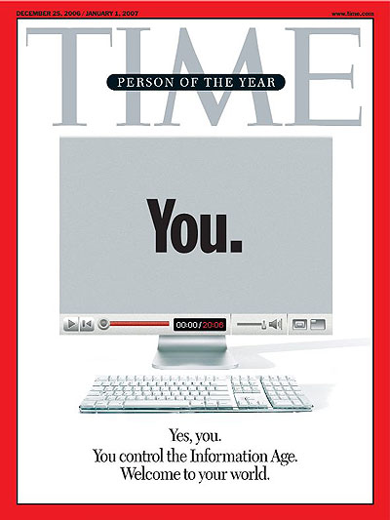
IS/MIS/CIS/CBIS: You as Informed Users
Informed User: A person knowledgeable about information systems and information technology.
You — Yes, You — Are TIME's Person of the Year: http://content.time.com/time/magazine/article/0,9171,1570810,00.html

Slide 12
How Does IT Impact Organizations and Our Life?
IT Reduces the Number of Middle Managers: The world becomes flat, so does the management.
IT Change’s the Manager’s Job: How?
Will IT eliminate some jobs? ATM, E-commerce, Uber, Airbnb……
IT creates jobs at the same time.

Slide 13
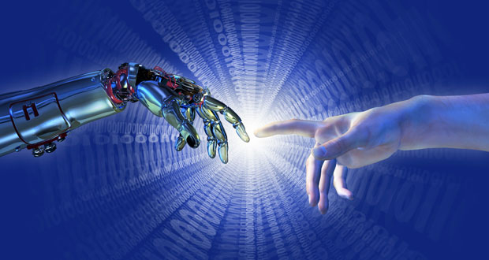

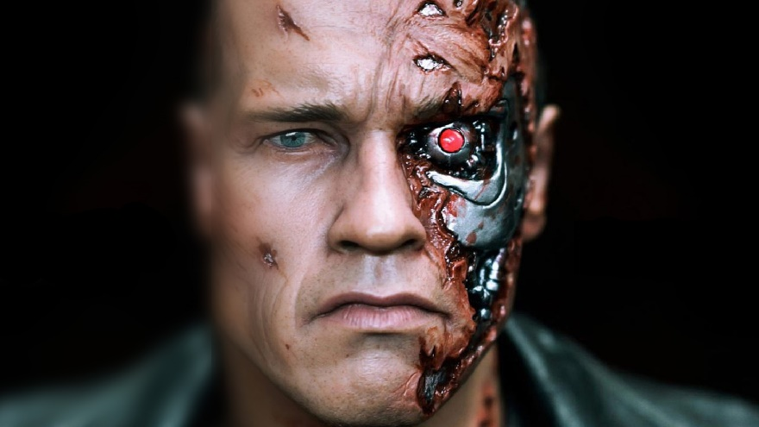
Importance of IS to Society
IT Affects Our Quality of Life
The Robot (AI) Revolution is Here Now: Machine Leaning, Deep Blue, Alpha Go……

Slide 14
Why Should We Study IS?
To Be An Informed User…
WE will benefit more from our organization’s IT applications because WE will understand what is “behind” those applications.
Our input can enhance our organization’s IT applications.
As WE enter the workforce, WE can assist in selecting the IT applications our organization will use.

Slide 15
Why Should We Study IS?
To Be An Informed User…
WE will be aware of both new IT and rapid developments in existing technologies.
WE will understand how using IT can improve our organization’s performance.
If WE are entrepreneurial minded, WE can use IT to start our own business.

Slide 16

Why Should We Study IS?
To Be Prepared for Career Opportunities
IT Jobs (Table 1.1, page 5):
Chief Information Officer (CIO)
Substantial Demand for IT Staff
  Programmers
  Business Analysts
  System Analysts
  Designers
$115,000 is the median salary for IS Managers (US Department of Labor)
Data Scientist: The Sexiest Job of the 21st Century: https://hbr.org/2012/10/data-scientist-the-sexiest-job-of-the-21st-century
……
Notes:
CIO: The executive who is in charge of the IS function

Slide 17
Why Should We Study IS?
To Manage Information Resources
Managing IS is difficult and complex and doable
Contributing Factors:
  Strategic value of IS
  Acquiring, operating, and maintaining IS is very expensive
  Evolution of the IS Function: Read interesting good stories in Innovators

Slide 18
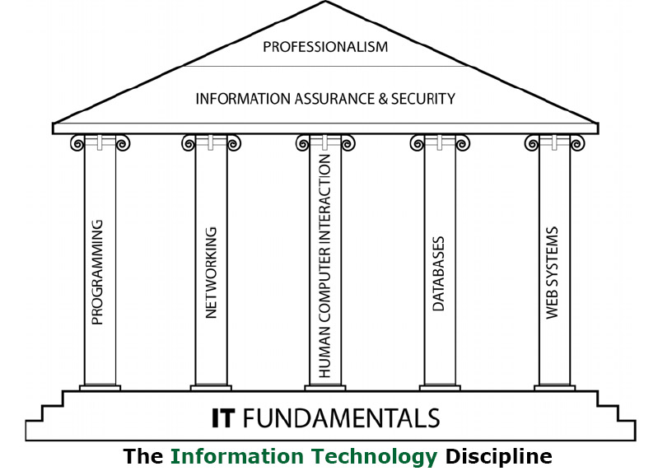
And, How? Build Our Skillset, Mindset, and Knowledge Base as an informed User to Capture Career Opportunities, and Effectively Manage Information Resources
Data analytics fits in here

Slide 19
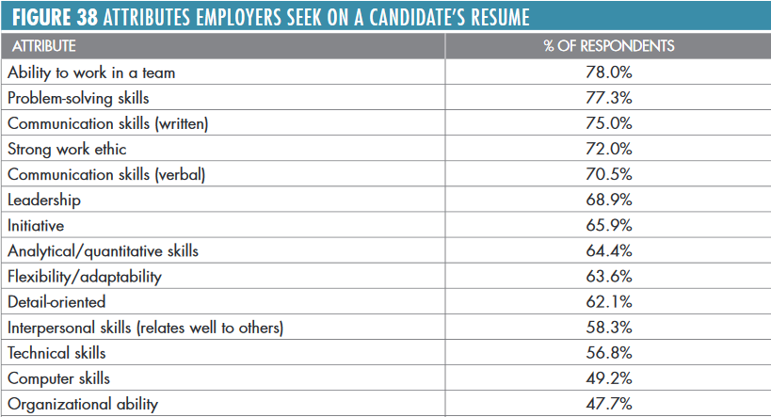
And, How? Skills, knowledge, and abilities employers are looking for in entry-level employees
Source: Job Outlook 2017, National Association of College and Employers

Slide 20
Summary:
Overview of Information Technology (IT).
Overview of Computer-Based Information Systems (IS/MIS/CIS/CBIS).
How Does IT Impact Organizations?
Importance of IS/MIS/CIS/CBIS to Society
Why Should We Study IS/MIS/CIS/CBIS?
And, How?

